Slide 1

Mulungushi University
School of Engineering and Technology
Computer Science Department
Web Technologies
(ICT251)
Introduction to HTML
Lecture 2

Slide 2
INTRODUCTION TO HTML

Slide 3
INTRODUCTION TO HTML
  With HTML you can create your own Web site.
  HTML stands for Hyper Text Markup Language.
  HTML is derived from a language SGML (Standard Graphics Markup Language).
  The future of HTML is XML (eXtended Markup Language).
  HTML is not a programming language, it is a Markup Language.
  A markup language is a set of markup tags.
  HTML uses markup tags to describe web pages.
  HTML is not case sensitive language.
  HTML documents contain HTML tags and plain text.

Slide 4
HOW TO START
  Write html code in notepad.
  Save the file with (.Html)/(.Htm) extension.
  View the page in any web browser viz. Google Chrome,Edge or Mozila firefox.
  The purpose of a web browser (like internet explorer or Mozila firefox) is to read html documents and display them as web pages.

Slide 5
HTML Elements and Tags
  A tag is always enclosed in angle bracket <>like <HTML>
  HTML tags normally come in pairs like <HTML> and </HTML> i.e.
Start tag = <HTML>
End tag =</HTML>
  Start and end tags are also called opening tags and closing tags

Slide 6
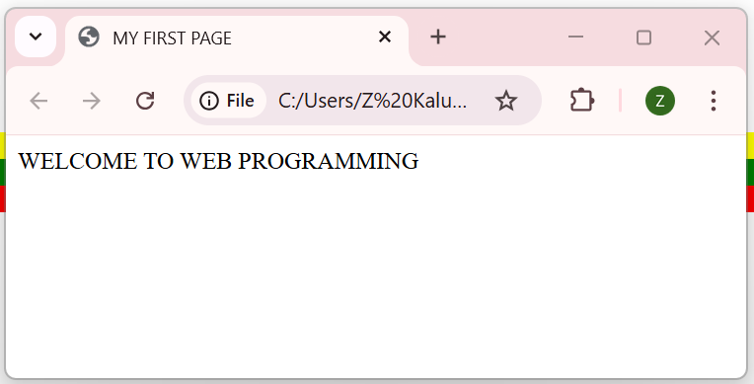
Code With HTML
<HTML>
<HEAD>
<TITLE>
MY FIRST PAGE
</TITLE>
</HEAD>
<BODY>
WELCOME TO WEB PROGRAMMING
</BODY>
</HTML>

Slide 7
Explain these tags
  <HTML> - Describe HTML web page that is to be viewed by a web browser.
  <HEAD> - This defines the header section of the page.
  <TITLE> - This shows a caption in the title bar of the page.
  <BODY> - This tag show contents of the web page will be displayed.

Slide 8
Types of HTML Tags
There are two different types of tags:->
Paired Tags also know as Container Element:->
Container Tags contains start tag and end tag i.e.
<HTML>… </HTML>
Unpaired Tags also know as Empty Element:->
Empty Tags contains start tag only i.e.
<BR>

Slide 9
Text Formatting Tags
Heading Element:->
  There are six heading elements (<H1>,<H2>,<H3>,<H4>, <H5>,<H6>).
  All the six heading elements are container tag and requires a closing tag.
  <h1> will print the largest heading
  <h6> will print the smallest heading

Slide 10
Heading Tag Code
<html>
<head><title>heading</title></head>
<body>
<h1> Mulungushi University</h1>
<h2> Mulungushi University</h2>
<h3> Mulungushi University</h3>
<h4> Mulungushi University</h4>
<h5> Mulungushi University</h5>
<h6> Mulungushi University</h6>
</body>
</html>

Slide 11
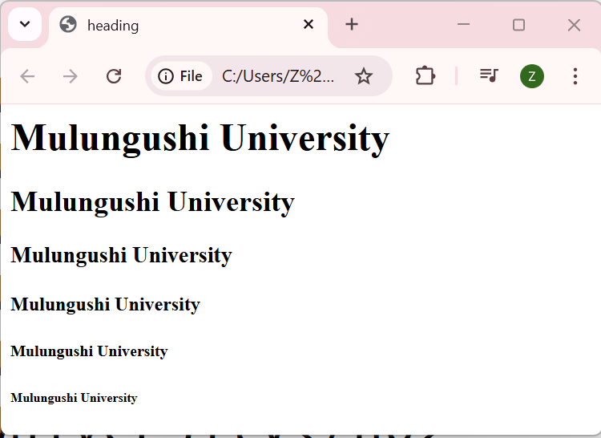
Result of Heading Code

Slide 12
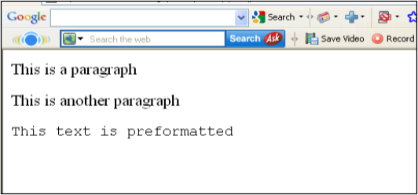
HTML Paragraph Tag
  HTML documents are divided into paragraphs.
  Paragraphs are defined with the <p> tag i.e.
<p>This is a paragraph</p>
<p>This is another paragraph</p>
<pre>This text is preformatted</pre>

Slide 13
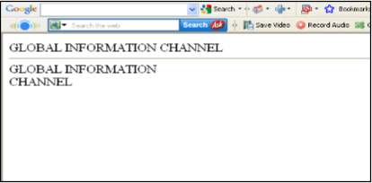
Line Break & Horizontal Line Tag
  if you want a line break or a new line without starting a new paragraph Use the <br> tag.
  Defines a horizontal line use <hr>tag.
  <br> <hr> element are empty HTML element i.e. Global Information Channel<hr>
Global Information <br> Channel

Slide 14
Text Formatting Tags
<b>
<big>
<em>
<i>
<small>
<strong>
<sub>
<super>
<ins>
<del>
<tt>
<u>
<strike>
Defines bold text
Defines big text
Defines emphasized text
Defines italic text
Defines small text
Defines strong text
Defines subscripted text
Defines superscripted text
Defines inserted text
Defines deleted text
Defines teletype text
Defines underline text
Defines strike text

Slide 15
Text Formatting Code
<html>
<head></head>
<body>
<b>This text is Bold</b>
<br><em>This text is Emphasized</em>
<br><i>This text is Italic</i>
<br><small>This text is Small</small>
<br>This is<sub> Subscript</sub> and <sup>Superscript</sup>
<br><strong>This text is Strong</strong>
<br><big>This text is Big</big>
<br><u>This text is Underline</u>
<br><strike>This text is Strike</strike>
<br><tt>This text is Teletype</tt>
</body>
</html>

Slide 16
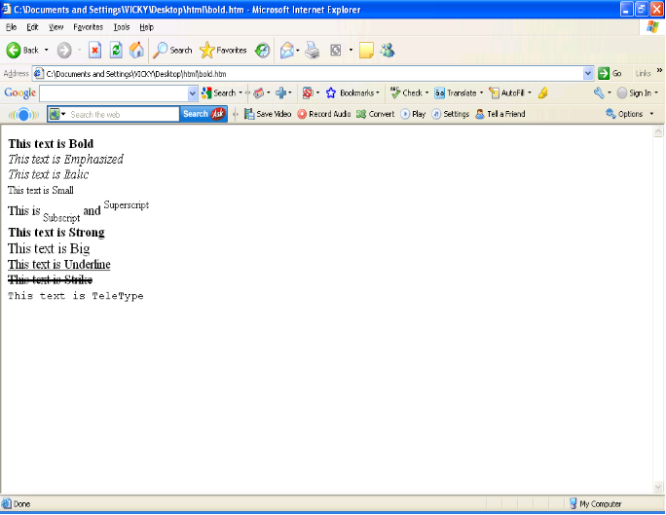
Result of Text Formatting Code

Slide 17
Font Tag
  This element is used to format the size, typeface and color of the enclosed text.
  The commonly used fonts for web pages are Arial, Comic Sans MS , Lucida Sans Unicode, Arial Black, Courier New, Times New Roman, Arial Narrow, Impact, Verdana.
  The size attribute in font tag takes values from 1 to 7.

Slide 18
Font Tag Code
<html>
<head><title> fonts</title></head>
<body>
<br><font color=“green" size="7" face="Arial"> GLOBAL INFORMATION CHANNEL </font>
<br><font color=“green" size="6" face="Comic Sans MS "> GLOBAL INFORMATION CHANNEL </font>
<br><font color=“green" size="5" face="Lucida Sans Unicode"> GLOBAL INFORMATION CHANNEL </font>
<br><font color=“green" size="4" face="Courier New"> GLOBAL INFORMATION CHANNEL </font>
<br><font color=“green" size="3" face="Times New Roman"> GLOBAL INFORMATION CHANNEL </font>
<br><font color=“green" size="2" face="Arial Black"> GLOBAL INFORMATION CHANNEL </font>
<br><font color=“green" size="1" face="Impact"> GLOBAL INFORMATION CHANNEL </font>
</body>
</html>

Slide 19
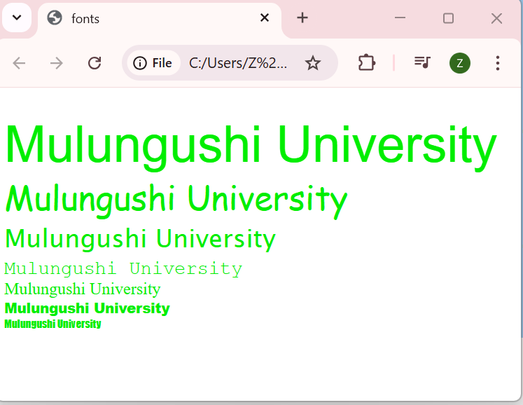
Result of Font Code

Slide 20
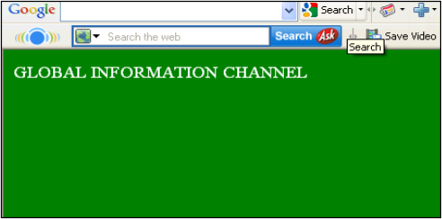
Background & Text Color Tag
  The attribute bgcolor is used for changing the back ground color of the page.
<body bgcolor=“Green” >
  Text is use to change the color of the enclosed text.
<body text=“White”>

Slide 21
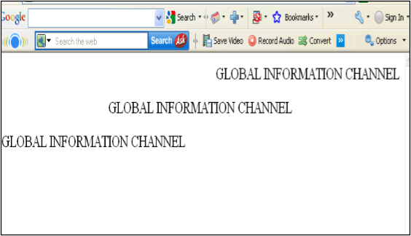
Text Alignment Tag
  It is use to alignment of the text.
      Left alignment <align=“left”>
      Right alignment <align=“right”>
      Center alignment <align=“center”>

Slide 22
Hyperlink Tag
  A hyperlink is a reference (an address) to a resource on the web.
  Hyperlinks can point to any resource on the web: an HTML page, an image, a sound file, a movie, etc.
  The HTML anchor element <a>, is used to define both hyperlinks and anchors.
<a href="url">Link text</a>
  The href attribute defines the link address.
<a href="http://www.globalinfochannel/">Visit globalinfochannel!</a>

Slide 23
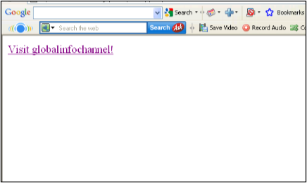

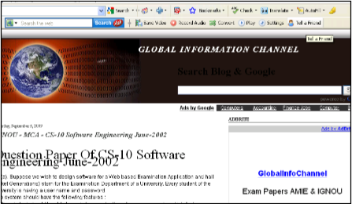
Result of Hyperlink Code

Slide 24
Image Tag
  To display an image on a page, you need to use the src attribute.
  src stands for "source". The value of the src attribute is the URL of the image you want to display on your page.
  It is a empty tag.
<IMG SRC =“url">
<IMG SRC="picture.gif“>
<IMG SRC="picture.gif“ HEIGHT="30" WIDTH="50">

Slide 25
Image attributes - <img> tag
<img>
<Src>
<Alt>
<Width>
<Height>
<Border>
<Hspace>
<Vspace>
<Align>
<background>
Defines an image
display an image on a page,Src stands for "source".
Define "alternate text" for an image
Defines the width of the image
Defines the height of the image
Defines border of the image
Horizontal space of the image
Vertical space of the image
Align an image within the text
Add a background image to an HTML page

Slide 26
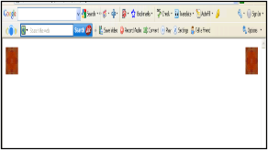
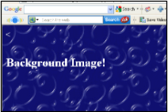
Code & Result of the Image
<html><body>
<p><img src="file:///C:/WINDOWS/Zapotec.bmp"
align="left" width="48" height="48"> </p>
<p><img src ="file:///C:/WINDOWS/Zapotec.bmp"
align="right" width="48" height="48"></p>
</body></html>
<HTML>
<<body background="file:///C:/WINDOWS/Soap%20Bubbles.bmp" text="white">
<br><br><br>
<h2> Background Image!</h2>
</BODY></HTML>

Slide 27
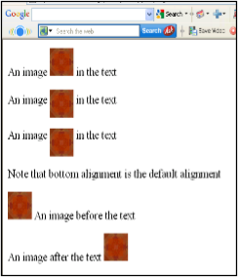
Code & Result of the Image
<html><body>
<p>An image
<img src="file:///C:/WINDOWS/Zapotec.bmp"
align="bottom" width="48" height="48"> in the text</p>
<p>An image
<img src ="file:///C:/WINDOWS/Zapotec.bmp"
align="middle" width="48" height="48"> in the text</p>
<p>An image
<img src ="file:///C:/WINDOWS/Zapotec.bmp"
align="top" width="48" height="48"> in the text</p>
<p>Note that bottom alignment is the default alignment</p>
<p><img src ="file:///C:/WINDOWS/Zapotec.bmp"
width="48" height="48">
An image before the text</p>
<p>An image after the text
<img src ="file:///C:/WINDOWS/Zapotec.bmp"
width="48" height="48"> </p>
</body></html>

Slide 28
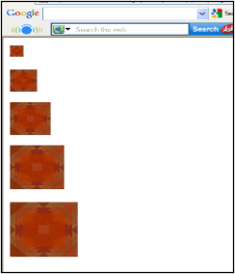
Code & Result of the Image
<html><body>
<p><img src="file:///C:/WINDOWS/Zapotec.bmp"
align="bottom" width="20" height="20"> </p>
<p><img src ="file:///C:/WINDOWS/Zapotec.bmp"
align="middle" width="40" height="40"></p>
<p><img src ="file:///C:/WINDOWS/Zapotec.bmp"
align="top" width="60" height="60"></p>
<p><img src ="file:///C:/WINDOWS/Zapotec.bmp"
width="80" height="80"> </p>
<p><img src ="file:///C:/WINDOWS/Zapotec.bmp"
width="100" height="100"> </p>
</body></html>

Slide 29
HTML Table Tag
<table>
<tr>
<td>
<th>
<Caption>
<colgroup>
<col>
<thead>
<tbody>
<tfoot>
<Cellspacing>
<Cellpadding>
<Colspan>
<rowspan>
<Border>
used to create table
table is divided into rows
each row is divided into data cells
Headings in a table
caption to the table
Defines groups of table columns
Defines the attribute values for one or more columns in a table
Defines a table head
Defines a table body
Defines a table footer
amount of space between table cells.
space around the edges of each cell
No of column working with will span
No of rows working with will span
attribute takes a number

Slide 30
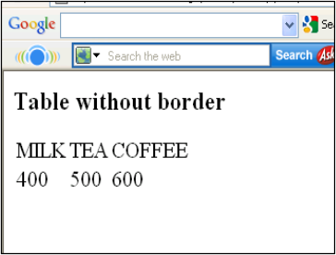
Code & Result of the Table
<html>
<body>
<h3>Table without border</h3>
<table>
<tr> <td>MILK</td>
<td>TEA</td>
<td>COFFEE</td> </tr>
<tr> <td>400</td>
<td>500</td>
<td>600</td> </tr>
</table>
</body>
</html>

Slide 31
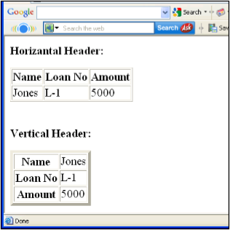
Table Code with Border & Header
<html><body>
<h4>Horizontal Header:</h4>
<table border="1">
<tr> <th>Name</th>
<th>Loan No</th>
<th>Amount</th> </tr>
<tr> <td>Jones</td>
<td>L-1</td>
<td>5000</td></tr> </table><br><br>
<h4>Vertical Header:</h4>
<table border="5">
<tr> <th>Name</th>
<td>Jones</td> </tr>
<tr> <th>Loan No</th>
<td>L-1</td> </tr>
<tr> <th>Amount</th>
<td>5000</td></tr> </table>
</body></html>

Slide 32
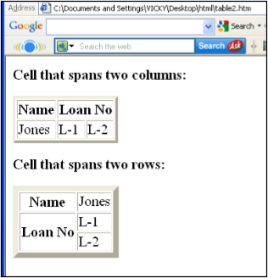
Table Code with Colspan & Rowspan
<html><body>
<h4>Cell that spans two columns:</h4>
<table border="4">
<tr> <th>Name</th>
<th colspan="2">Loan No</th> </tr>
<tr> <td>Jones</td>
<td>L-1</td>
<td>L-2</td> </tr> </table>
<h4>Cell that spans two rows:</h4>
<table border="8">
<tr> <th>Name</th>
<td>Jones</td></tr><tr>
<th rowspan="2">Loan No</th>
<td>L-1</td></tr><tr>
<td>L-2</td></tr></table>
</body></html>

Slide 33
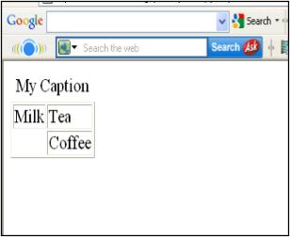
Table Code with Caption & ColSpacing
<html>
<body>
<table border="1">
<caption>My Caption</caption>
<tr>
<td>Milk</td>
<td>Tea</td>
</tr>
<tr>
<td></td>
<td>Coffee</td>
</tr>
</table>
</body>
</html>

Slide 34
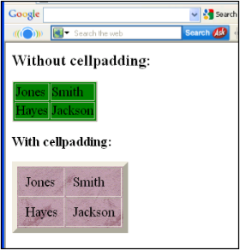
Cellpadding,Image & Backcolor Code
<html><body>
<h3>Without cellpadding:</h3>
<table border="2" bgcolor="green">
<tr> <td>Jones</td>
<td>Smith</td></tr>
<tr> <td>Hayes</td>
<td>Jackson</td></tr></table>
<h4>With cellpadding:</h4>
<table border="8"
cellpadding="10" background="file:///C:/WINDOWS/FeatherTexture.bmp">
<tr> <td>Jones</td>
<td>Smith</td></tr>
<tr> <td>Hayes</td>
<td>Jackson</td></tr></table>
</body></html>

Slide 35
Code to Display the Zambian Flag
<tr><td bgcolor='Green'>Green</td>
<td bgcolor='Green'>Green</td>
<td bgcolor='Green'>Green</td>
<td bgcolor='Red'>Red</td>
<td bgcolor='Black'>Black</td>
<td bgcolor='Orange'>Orange</td>
</tr>
<tr><td bgcolor='Green'>Green</td>
<td bgcolor='Green'>Green</td>
<td bgcolor='Green'>Green</td>
<td bgcolor='Red'>Red</td>
<td bgcolor='Black'>Black</td>
<td bgcolor='Orange'>Orange</td>
</tr>
<tr bgcolor='green'><td bgcolor='Green'>Green</td>
<td bgcolor='Green'>Green</td>
<td bgcolor='Green'>Green</td>
<td bgcolor='Red'>Red</td>
<td bgcolor='Black'>Black</td>
<td bgcolor='Orange'>Orange</td>
</tr>
</table>
</BODY>
</HTML>
<HTML>
<HEAD>
<TITLE>
My Web
</TITLE>
</HEAD>
<BODY>
<table>
<tr bgcolor='Green'><td bgcolor='Green' border='0'>Green</td>
<td bgcolor='Green'>Green</td>
<td bgcolor='Green'>Green</td>
<td bgcolor='Green'>Green</td>
<td bgcolor='Green'>Green</td>
<td bgcolor='Green'>Green</td>
</tr bgcolor='Green'>
<tr><td bgcolor='Green'>Green</td>
<td bgcolor='Green'>Green</td>
<td bgcolor='Green'>Green</td>
<td bgcolor='Green'>Green</td>
<td bgcolor='Green'>Green</td>
<td bgcolor='Green'>Green</td>
</tr>

Slide 36
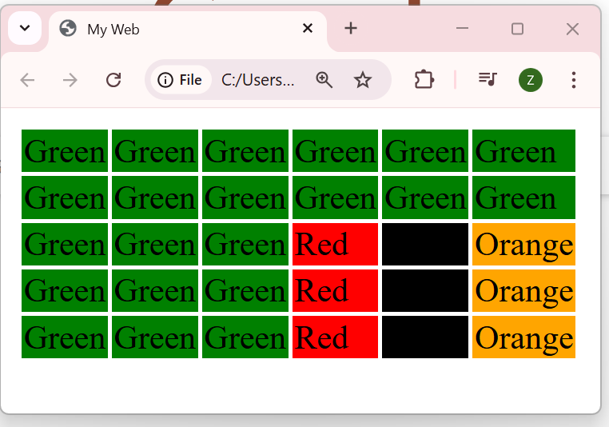
Results on the Web Browser

Slide 37
HTML List Tag
  Lists provide methods to show item or element sequences in document content. There are three main types of lists:->
  Unordered lists:-unordered lists are bulleted.
  Ordered lists:- Ordered lists are numbered.
  Definition lists:- Used to create a definition list .

Slide 38
List Tags
<LI>
<OL>
<UL>
<DL>
<DT>
<DD>
<LI> is an empty tag,it is used for representing the list items
Ordered list
Unordered list
Defines a definition list
Defines a term (an item) in a definition list
Defines a description of a term in a definition list

Slide 39
Unordered List
  TYPE attribute to the <UL> tag to show different bullets like:-
      Disc
      Circle
      Square
<ul Type =“disc”>…..</ul>
  The attribute TYPE can also be used with <LI> element.

Slide 40
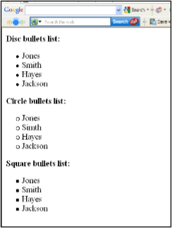
Code & Result of the Unordered List
<html><body>
<h4>Disc bullets list:</h4>
<ul type="disc"> <li>Jones</li>
<li>Smith</li>
<li>Hayes</li>
<li>Jackson</li></ul>
<h4>Circle bullets list:</h4>
<ul type="circle"> <li>Jones</li>
<li>Simth</li>
<li>Hayes</li>
<li>Jackson</li></ul>
<h4>Square bullets list:</h4>
<ul type="square"> <li>Jones</li>
<li>Smith</li>
<li>Hayes</li>
<li>Jackson</li></ul>
</body></html>

Slide 41
Ordered List
  The TYPE attribute has the following value like:-
      TYPE = "1" (Arabic numbers)
      TYPE = "a" (Lowercase alphanumeric)
      TYPE = "A" (Uppercase alphanumeric)
      TYPE = "i" (Lowercase Roman numbers)
      TYPE = "I" (Uppercase Roman numbers)
  By default Arabic numbers are used

Slide 42
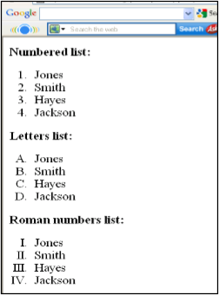
Code & Result of the Ordered List
<html><body>
<h4>Numbered list:</h4>
<ol> <li>Jones</li>
<li>Smith</li>
<li>Hayes</li>
<li>Jackson</li></ol>
<h4>Letters list:</h4>
<ol type="A"> <li>Jones</li>
<li>Smith</li>
<li>Hayes</li>
<li>Jackson</li></ol>
<h4>Roman numbers list:</h4>
<ol type="I"> <li>Jones</li>
<li>Smith</li>
<li>Hayes</li>
<li>Jackson</li></ol>
</body></html>

Slide 43
What is <marquee>?
<marquee> is an HTML tag that makes content auto-scroll (like a news ticker). It still works in some browsers, but it’s not part of HTML and shouldn’t be used for modern sites (accessibility + mobile issues). Prefer CSS animations instead.

Slide 44
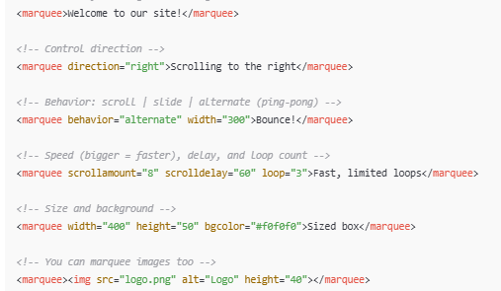
<marquee> Tag

Slide 45

Code and Result
<HTML>
<HEAD>
<TITLE>
My Web
</TITLE>
</HEAD>
<BODY>
<Marquee behavior='scroll' bgcolor='yellow'>SCROLL</Marquee>
<Marquee behavior='SLIDE' bgcolor='green'>SLIDE</Marquee>
<Marquee behavior='Alternate' bgcolor='red'>Alternate</Marquee>
</BODY>
</HTML>

Slide 46
END

